Slide 1
Hadronic Dark Matter
Kuksa Vladimir
Southern Federal University
QFTHEP 2019
Sochi, Russia, Sept. 22-29

Slide 2
Contents
New heavy hadrons as Dark Matter particles.
Experimental restrictions on new quarks.
Quantum numbers and quark structure of new heavy hadrons.
Main properties of new mesons as DM particles.
Low-energy interactions of DM particles with nucleons.
Conclusions.

Slide 3
New heavy quarks and hadronic DM

Slide 4
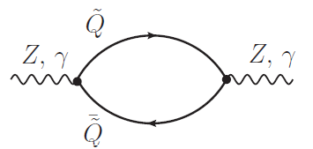
Exp. restrictions on Q

Slide 5
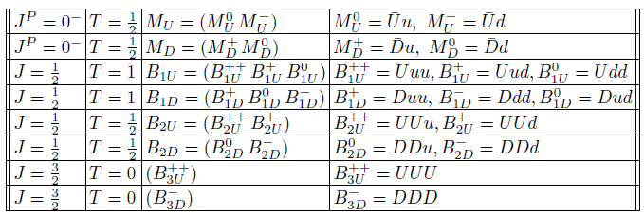
Quantum numbers and quark structure of new hadrons

Slide 6
Main properties of new mesons

Slide 8
Low-energy MN -interaction

Slide 9
Conclusions
HDM is not excluded by EW and CC restrictions
Large mass of new DM hadrons (100 TeV)
Signals of charge M-decay: low-energy leptons
Hyperfine mass-splitting in M-M*: signal - low-energy photons (KeV) and dissipative low-energy transition in DM
Analysis of HDM scenario with account of M*, co-annihilation and number-changing processes

